Slide 1





SUSTAINFIT
Energize Your Workout

Slide 2





Introduction
Employing fitness equipment—specifically, the treadmill and spin bike—to generate power assists in addressing urban energy needs, reducing dependency on non-renewable resources, and enhancing environmental sustainability.
The objectives of the initiative are to stimulate the use of green energy, develop eco-friendly exercise, enhance gym energy efficiency, and provide revenue opportunities.
The project intends to eliminate the intermittent nature and reliance on environmental components of current renewable energy sources, such as hydropower, wind, and solar power.
The initiative mitigates the upfront expenses and regional constraints connected with conventional renewable energy alternatives.
The concept outperforms conventional exercise equipment that generates power, delivering increased efficiency to satisfy both internal and exterior energy requirements.

Slide 3




Mission Statement
Our goal is to revolutionize fitness equipment by incorporating sustainable practices into exercise regimens.
Our primary objective is to develop fitness equipment that generates renewable electricity from human energy.
The generator then transforms this rotational energy produced during the workout into electricity, which can be used to power the lights, other gym equipment, and fed into the grid.
Data science plays a key role in collecting real-time data on each user's workout and energy output, offering personalized feedback that motivates them to contribute to a sustainable future while improving their fitness. Predictive analytics are used to help gym management plan energy storage and optimize grid feed-in strategies.
Our purpose is to promote environmentally friendly energy sources, encourage active, healthy lifestyles, and assist gyms throughout the globe in establishing economically sustainable energy centers.

Slide 4



Problem Statement
Develop a gym's infrastructure employing Spin Bike and Treadmill which can convert human motion into electrical energy through kinetic energy recovery systems (KERS).
Employ cutting-edge energy conversion technologies to store and retrieve mechanical energy generated during exercise for operational purposes, such as energy storage systems and high-efficiency generators.
Install an Internet of Things-enabled energy monitoring system that gives each user session access to real-time data analytics on power generation, energy efficiency, and environmental impact indications.
Enhanced User Engagement with Gamification: Incorporate gamification components to encourage gym attendance and support sustainability, and use data-driven dashboards that display individual energy contributions and environmental effect.
Make sure the system is affordable, adaptable to various gym sizes, and has a smooth interface that integrates training equipment and renewable energy technology.

Slide 5
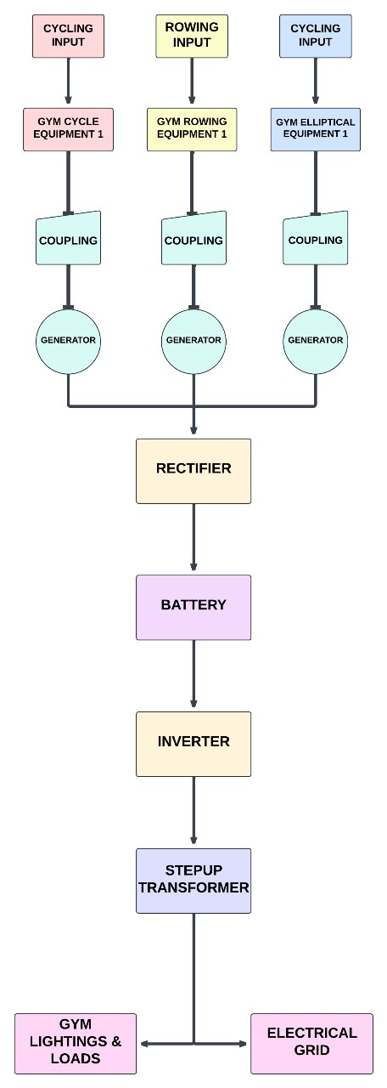
Solution
Mechanical energy is produced as we attempt to peddle the Spin Bikes. Electricity is a possible conversion of this mechanical energy.
The pedal will have a magnet attached to the bottom to create electric current, which can be utilized for converting AC to DC via a rectifier. In furtherance of retaining additional energy, this DC power can be enhanced in effectiveness by being stored in batteries.
We also employ a relay to carry out switching operations in conjunction with an inverter (DC-AC). This is a consequence of the fact that the gym is limited to morning and evening hours and cannot be open around the clock.
Therefore, we can generate a significant amount of power in this short amount of time, but we can still make use of boost converter circuits to increase the energy that is produced.
As a result, we may use this to power domestic appliances such as the lights in the surrounding houses including the gym. If an interruption in power happens during the generation of power, the loads will be maintained by battery chargers.
By using a relay, which functions as a switch, we can choose the power source—either generated electricity or power from a battery charger—that we want to use for our loads. Thus, providing a practical and renewable energy source for everyday use.

Slide 6



Uniqueness & Benefits
Uniqueness:
Embedding sustainability into fitness: The primary objective is to design state-of-the-art gym equipment that transforms human exercise into renewable energy.
Real-time energy tracking: Gym-goers can see the tangible effect of their workouts on renewable energy production.
Seamless integration of performance, technology, and ecology: The gym aims to combine fitness goals with environmental consciousness.
Economic viability: The goal is to make sustainable gym equipment economically feasible for gyms worldwide.
Benefits:
Reduced ecological footprint: Gyms can significantly reduce their environmental impact.
Renewable energy generation: The equipment can contribute to the production of clean energy.
Encouraging active, healthy lives: The focus on fitness promotes a healthy lifestyle.
Positive impact on climate change: By contributing to renewable energy, the regime can help mitigate climate change.
Sustainable future: The collaboration between human wellness and planetary welfare aims to establish a sustainable future.

Slide 7



Target
1. People who are interested in reducing their carbon footprint and who lay an emphasis on sustainability. Such consumers are probably attracted to the notion of working out in gyms that produce renewable energy.
2. Regular participants at the fitness center who are attracted to modern training environments. Their sense of efficiency and purpose may be strengthened by the thought of contributing to the production of energy while they work.
3. Managers and owners of gymnasiums who want to draw in members who care about the environment, save expenses through the generation of some of their energy, and set themselves separate from the competition.
4. Corporations who focus a high priority on health and wellbeing can incorporate this type of gym equipment in their green initiatives, a combination of sustainability with worker fitness.
5. These systems may be deployed by sustainability-focused universities, schools and colleges to broaden student awareness of and encouragement of green energy initiatives.
6. A significant target market can involve city planners and public recreation facilities seeking to integrate sustainable solutions into their parks or fitness centers.
7. The idea of employing exercise to create electricity through kinetic energy could attract the curiosity of those who are interested in innovative and cutting-edge technologies.
8.Architects and planners designing environmentally friendly structures and sustainable urban environments could discover that gym equipment that produces power is an excellent suit for their designs.

Slide 8
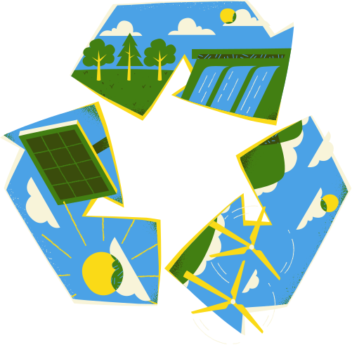







Conclusion
The proposed fitness regime aims to revolutionize the industry by integrating sustainability into every aspect of the workout experience. By transforming human exercise into renewable energy and providing real-time feedback on environmental impact, the initiative seeks to inspire individuals to lead healthier, more sustainable lives. Through technological innovation and economic viability, the goal is to make sustainable fitness accessible to gyms worldwide, contributing to a cleaner and more equitable future. By aligning with the United Nations Sustainable Development Goals—specifically SDG 3 (Good Health and Well-Being), SDG 7 (Affordable and Clean Energy), SDG 9 (Industry, Innovation, and Infrastructure), SDG 11 (Sustainable Cities and Communities), SDG 12 (Responsible Consumption and Production), and SDG 13 (Climate Action)—the project maximizes its impact in both the fitness and sustainability markets, targeting gyms, fitness centers, corporate wellness programs, educational institutions, and other groups.

